Slide 1
Marketing Report - Fabcom Participation at the 18th Africa International Housing Show 2024
Fabcom Structural Limited participation in the 18th Africa International Housing Show 2024 as a Silver Sponsor, in partnership with New Material Nigeria Company, yielded positive results in terms of brand awareness and lead generation. The event, hosted by Festus Adebayo and supported by Housing TV Africa, provided a platform to showcase innovative roofing solutions, especially colored steel long span roofing sheets. While direct sales were limited, a substantial number of qualified leads were generated.

Slide 2
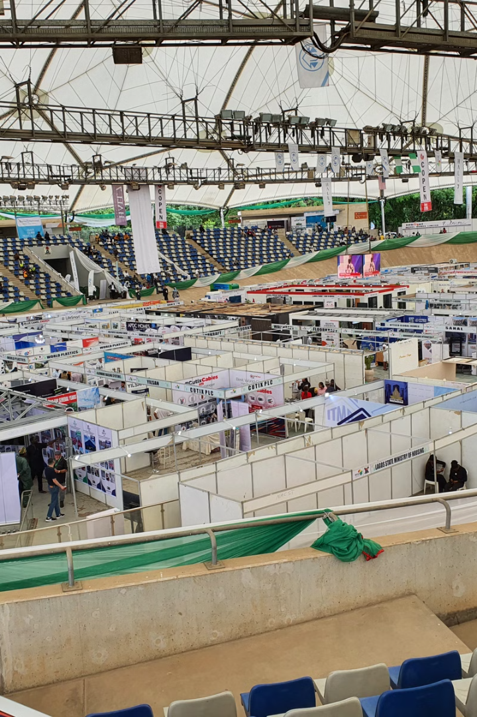
Event Overview
The 18th Africa International Housing Show is a prominent event in Africa's construction and housing industry. Attracting contractors, architects, developers, government officials, and homeowners, the show offered a platform for Fabcom to showcase roofing products.
1
Industry Gathering
The show was a significant industry gathering with over 100 sponsors and exhibitors.
2
Media Presence
Media partners such as TV News, Eye on Housing, Housing TV Africa, Housing Development TV, and AIT covered the event.
3
Professional Bodies
Leadway Assurance and Protech Nigeria were present at the event.
4
Government Officials
Arc Ahmed Musa Dangiwa (Minister of Housing and Urban Development), Dr. Marcus O. Ogunbiyi (Permanent Secretary), and other key figures attended the show.

Slide 3
Notable Participants
Industry leaders graced the event with their presence. Among them were Dr. Marcus O. Ogunbiyi, PST. Matthew Ashimolowo, the chairman of Majarios: The Luxury Place, Barr. Ify Umunnakwe-Okeke, the Founder of Lexon Capital, Mr. Taiwo Joda, MD of Accion Microfinance Bank, Mr. Adedeyi Adesemoye, Former Director CBN, Nigeria, and Dr. Marja Hoek-SMIT, founder and director of the international housing finance program, who delivered a keynote speech on the progress of housing to CEO Forum attendees.
Dangote Cement, Royal, Brains & Hammers, Cosgrove, Urban Shelter, NMRC, Constrix, Lafarge, Hall 7, Jiu Hua Housing, Federal Mortgage, Copen, First Trust Mortgage Bank, Berger, Think-Lab Group, CDK, and others were sponsors.
Major Companies
Estate Developers
SOW Estate, Periwinkle Empire, Martin Doks Homes, and Benyville Homes were present.

Slide 4
Marketing Objectives and Strategy
Fabcom aimed to increase brand awareness and generate qualified leads. Strategies included a visually appealing booth design, knowledgeable booth staff, distribution of marketing materials, social media promotion, and booth activation and design.
Booth Design
Marketing Collateral
Lead Generation
The open and inviting booth featured a product video, branded materials, and giveaways. However, interactive elements and product demonstrations were limited, impacting customer engagement.
Brochures, product samples, and business cards were distributed. Developing product spec sheets, prototypes, and case studies could enhance collateral effectiveness.
Business card collection and lead forms were used. Quantifying lead numbers and assessing quality based on job titles, company size, and project stage is crucial.

Slide 5
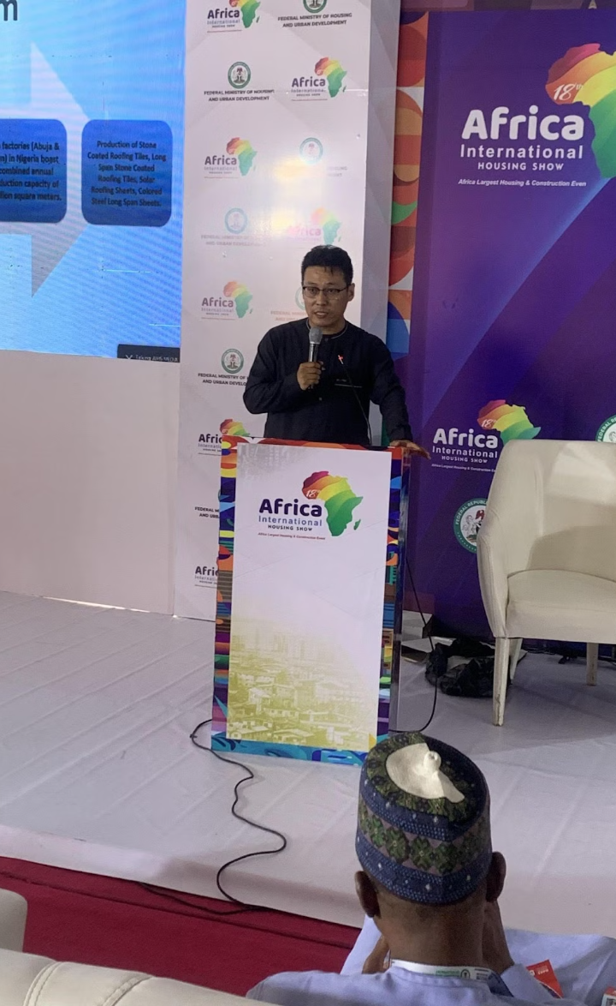
Brand Awareness and Customer Feedback
Media coverage, CEO forum participation, and strong social media metrics contributed to increased brand awareness. Positive feedback on colored steel long span roofing sheets was received, but there was a desire for more color options. Customer concerns about solar roofing sheet wattage and pricing were noted.
Positive Feedback
Positive feedback on colored steel long span roofing sheets was received, but there was a desire for more color options.
Customer Concerns
Customer concerns about solar roofing sheet wattage and pricing were noted.
Brand Awareness
Media coverage, CEO forum participation, and strong social media metrics contributed to increased brand awareness.

Slide 6
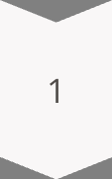
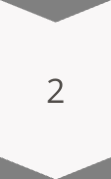
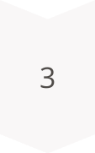
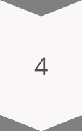
Competitor Analysis
Competitors with larger booths, interactive elements, and giveaways presented challenges. Focusing on product quality, customer service, and competitive pricing can differentiate Fabcom.
Larger Booths
Competitors with larger booths, interactive elements, and giveaways presented challenges.
Product Quality
Focusing on product quality, customer service, and competitive pricing can differentiate Fabcom.
Customer Service
Focusing on product quality, customer service, and competitive pricing can differentiate Fabcom.
Competitive Pricing
Focusing on product quality, customer service, and competitive pricing can differentiate Fabcom.

Slide 7
Recommendations
Enhance booth experience with interactive elements, product demonstrations, and Q&A sessions. Expand color options for long span stone coated roofing sheets. Develop detailed product information through spec sheets and case studies. Implement lead attraction strategies to encourage booth visits. Explore additional marketing channels like email and live video marketing.
Enhance Booth Experience
Expand Color Options
Enhance booth experience with interactive elements, product demonstrations, and Q&A sessions.
Expand color options for long span stone coated roofing sheets.
Develop Detailed Product Information
Implement Lead Attraction Strategies
Develop detailed product information through spec sheets and case studies.
Implement lead attraction strategies to encourage booth visits.

Slide 8
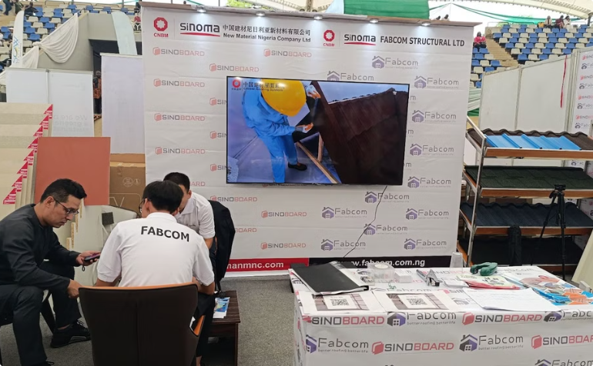
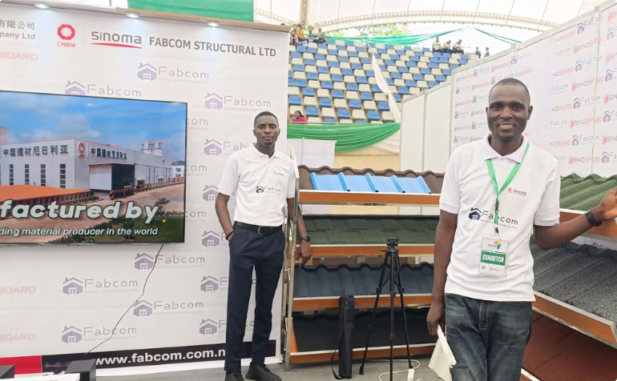
Booth Photos
The booth photos showcase the Fabcom presence at the 18th Africa International Housing Show 2024. The photos capture the booth design, product displays, and interactions with visitors.
Booth Design
Product Displays
The booth photos showcase the Fabcom presence at the 18th Africa International Housing Show 2024.
The photos capture the booth design, product displays, and interactions with visitors.

Slide 9
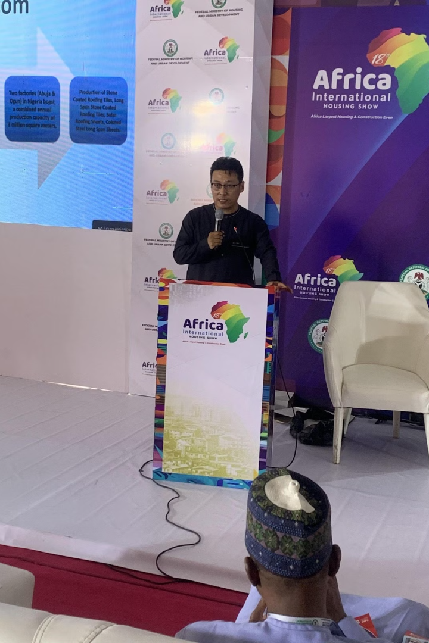
CEO Forum
The CEO Forum provided a platform for industry leaders to discuss key issues and trends in the housing sector. Fabcom's participation in the forum enhanced brand visibility and provided opportunities for networking and knowledge sharing.
1
Industry Leaders
The CEO Forum provided a platform for industry leaders to discuss key issues and trends in the housing sector.
2
Brand Visibility
Fabcom participation in the forum enhanced brand visibility and provided opportunities for networking and knowledge sharing.
3
Networking and Knowledge Sharing
Fabcom participation in the forum enhanced brand visibility and provided opportunities for networking and knowledge sharing.

Slide 10
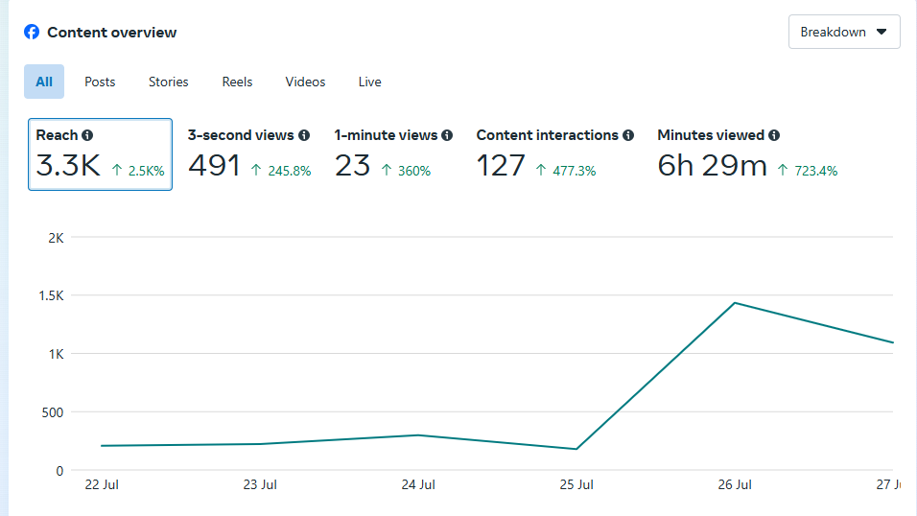
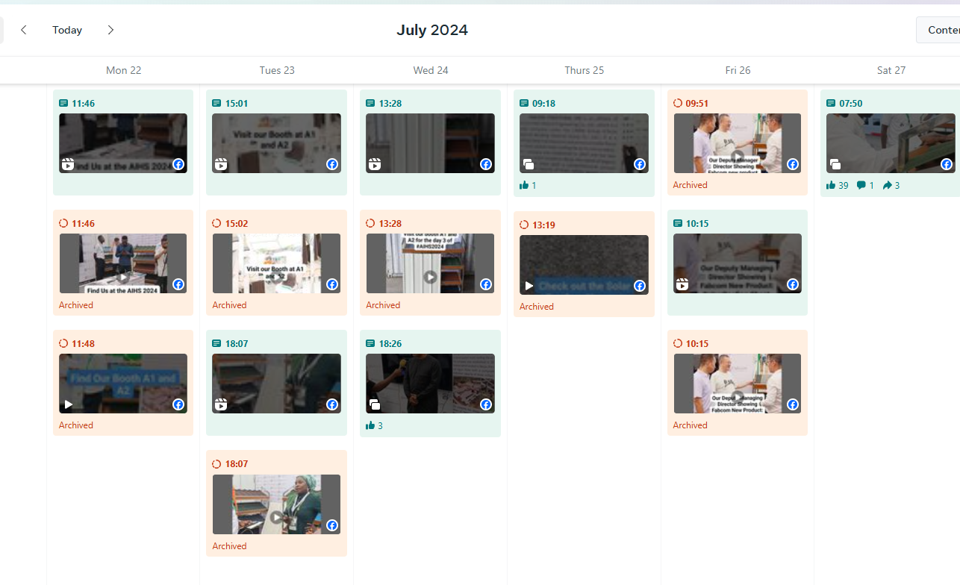
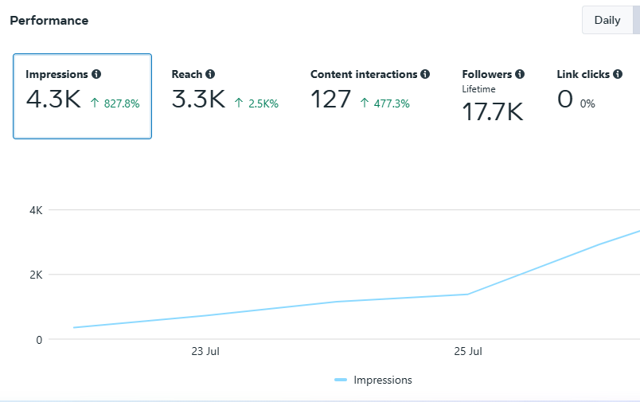
Social Media Analytics
Social media analytics provide insights into the reach and engagement of Fabcom marketing efforts during the housing show. The data reveals the effectiveness of social media campaigns in promoting brand awareness and generating interest in Fabcom products.
Reach and Engagement
Brand Awareness
Social media analytics provide insights into the reach and engagement of Fabcom marketing efforts during the housing show.
The data reveals the effectiveness of social media campaigns in promoting brand awareness and generating interest in Fabcom products.

